Slide 1
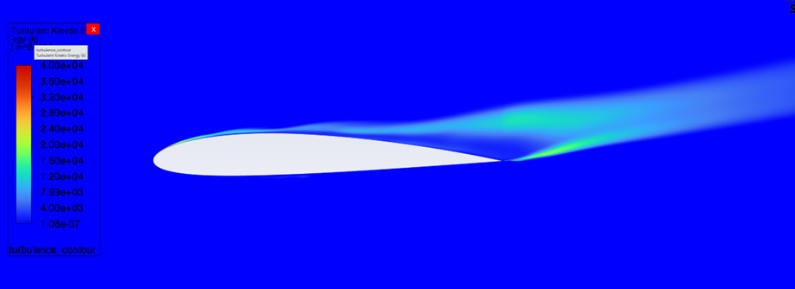
Flow over a 2-D 2412 Airfoil
Gerardo Sandoval
CFD simulation at Mach 1.5 and 16° AOA using turbulence modeling in ANSYS Fluent
Notes:
Hello everyone. My name is Gerardo Sandoval and the title of my CFD project is Flow over a 2D 2412 Airfoil.

Slide 2
Overview of Presentation
Project Background
Methods
Figures
Validation and Verification
Key Results and Conclusion
References and Appendix
Notes:
The outline of this presentation is as follows: Project Background, Methods, Figures, Validation and Verification, and Key Results and Conclusion. References and Appendix slides are included at the end of the slide deck.
In the project background, I will explain the motivations of the project and its goals.
In methods, I will state how I used Ansys Workbench and Fluent to simulate 2D flow over an airfoil.
In the figures slides, I will show my Fluent methods and Results.
Finally, in the Key Results and Conclusion, I will summarize the results and challenges and state future improvements of this CFD project.

Slide 3
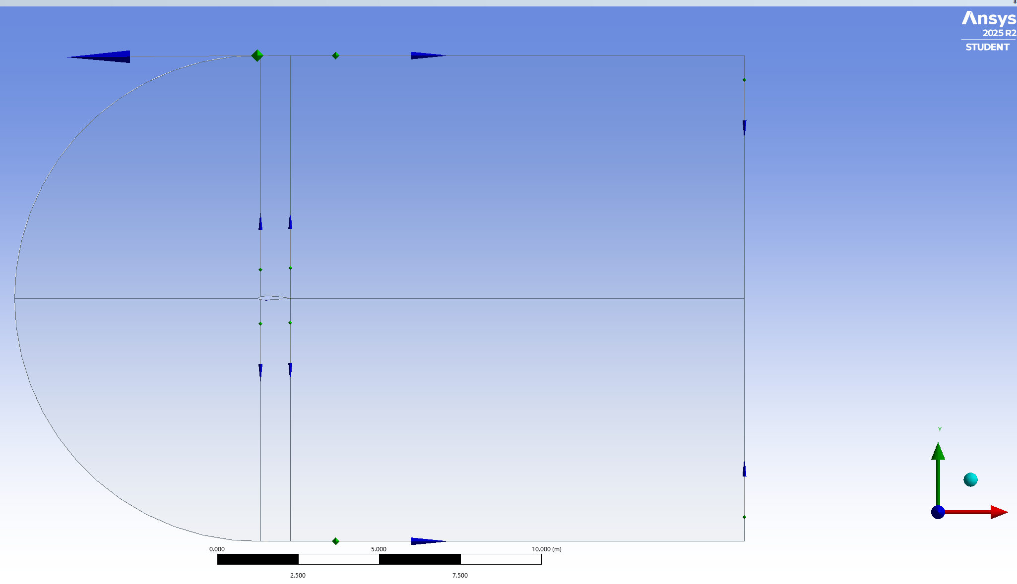
Project Background
Figure 1. Geometry of the Airfoil and the Fluid Domain in Ansys Design Modeler.
Goal – Lift and Drag Coefficients and Flow Contours
2-D Flow over Airfoil is simple.
Mach speeds of 0.13, 1.0, and 1.5.
Ansys Fluent Results are compared to NASA experimental data.
At Mach 1.0 and 1.5, density-based solver is used to capture turbulence.
Notes:
Project Background
The goal of this project is to determine the lift and drag coefficients and relevant flow contours.
The motivation for this project was that 2D airfoil simulations are simple to set up and there is existing experimental data easily available to compare Fluent data results.
The Mach Speeds used were 0.13, 1.0, and 1.5. Figure 1 shows the geometry of the airfoil and the fluid domain in Ansys Design Modeler.

Slide 4
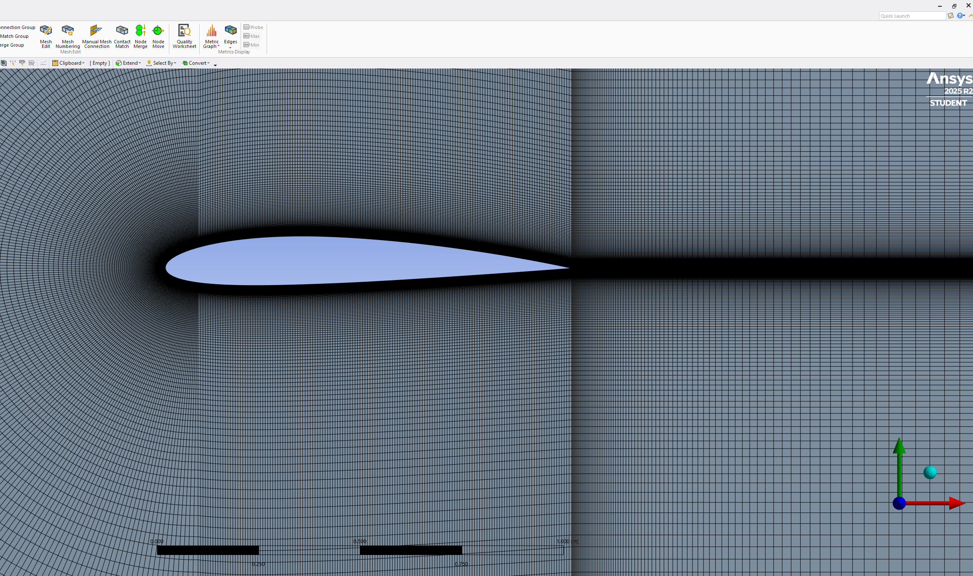
Methods - Ansys Workbench
Created 2-D Airfoil Geometry with Excel and coordinate data.
Generated Mesh and Defined Boundary Conditions
Ran Fluent using
2-D Flow
Viscous -> SST k-omega , 1000 Iterations.
Mach 0.13 at 0-, 8-, and 16-degrees angle of attack.
Mach 1.0 at 0- degree angle of attack.
Mach 1.5 at 16-degrees angle of attack.
Figure 2. Structured Mesh
Notes:
Now onto Methods
In Ansys Workbench, I created the 2D geometry by downloading airfoil coordinate data and editing it in Excel and importing it to Design Modeler.
The mesh was generated by creating 5 meshes from 5 faces of the 2D geometry and the inlet and outlet were defined. Figure 2 shows the structured mesh.
After mesh generation, I ran Fluent using the settings – 2D Flow, Viscous setting, and 1000 number of iterations.

Slide 5
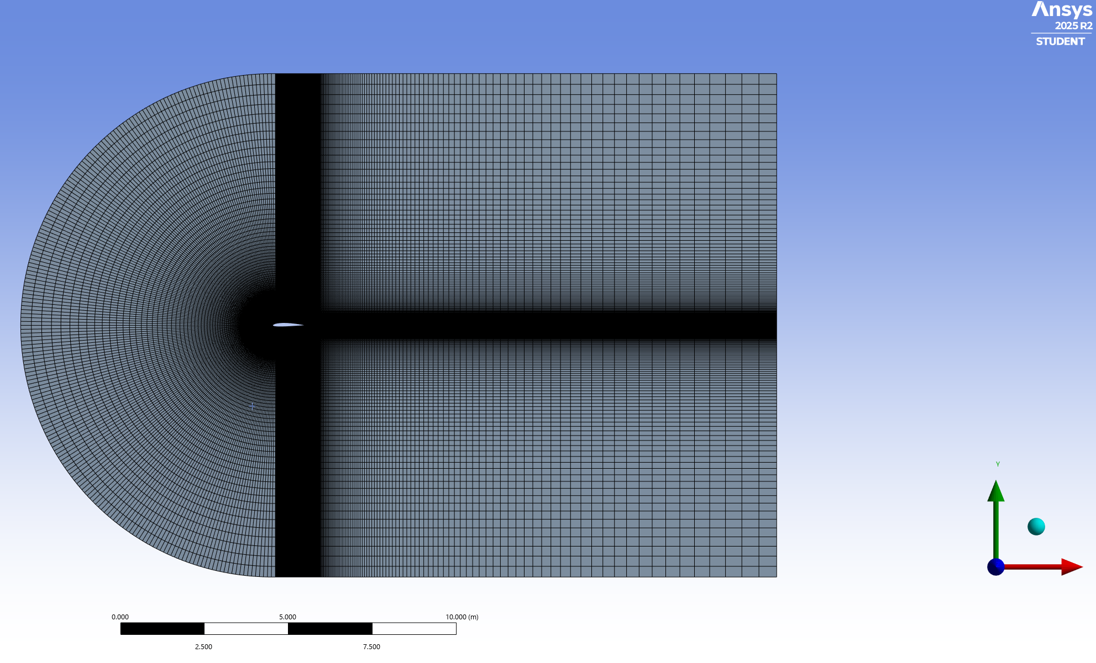
Figure 3. Full Mesh 2412 Airfoil
Notes:
Figure 3 Shows the full mesh. Note that the mesh to the left of the airfoil is a lot more detailed than the right side.

Slide 6
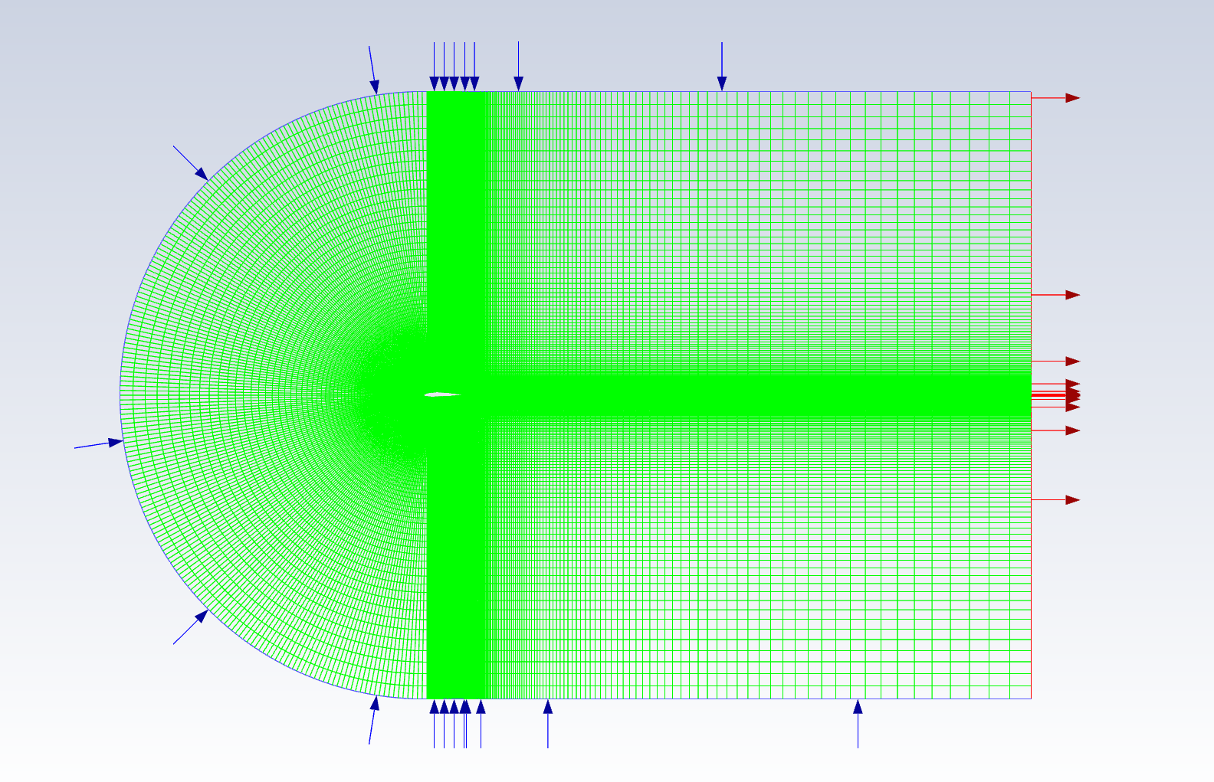
Figure 4. Inlet and Outlet in Fluent
Notes:
Figure 4 shows the inlet and outlet of the fluid region in Ansys Fluent.

Slide 7
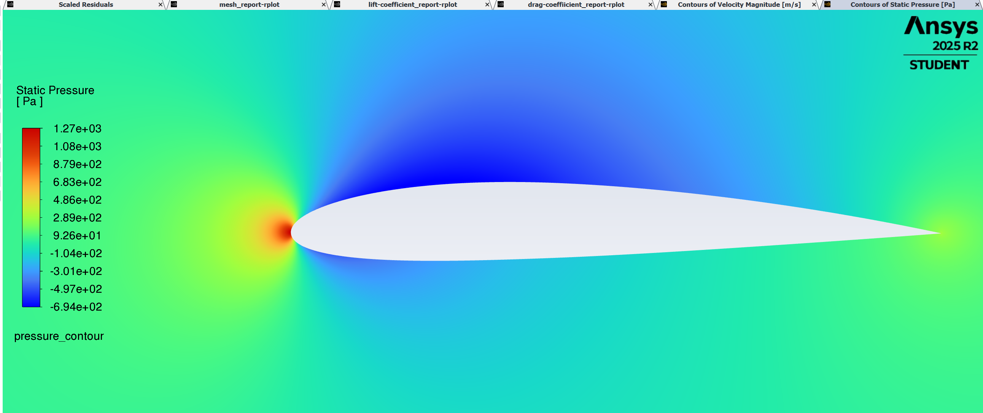
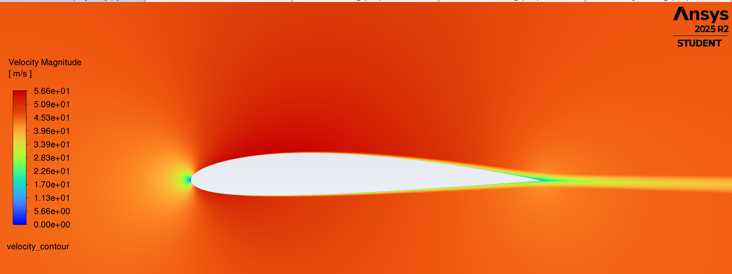
Figures 5 and 6 Pressure and Velocity Contours at Mach 0.13 (45 m/s) at 0-degree angle.
Notes:
Figures 5 and 6 show the pressure and velocity contours at Mach 0.13 (45 m/s) at 0-degree angle of attack.

Slide 8

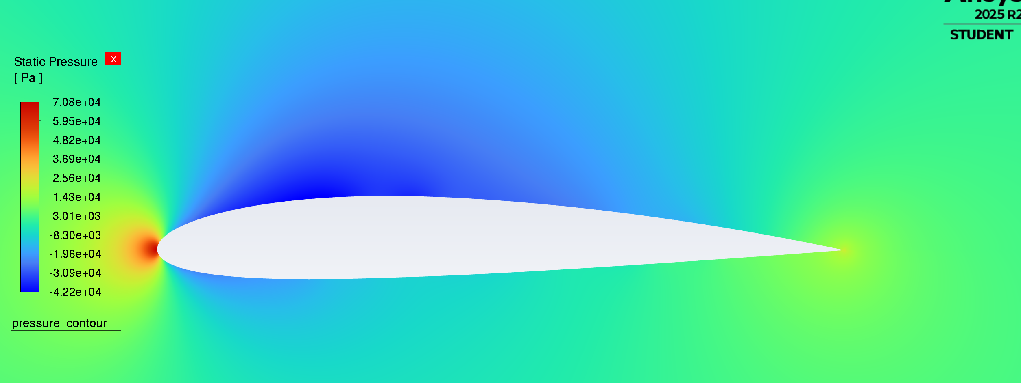
Figures 7 and 8 Turbulence and Pressure Contours at Mach 1.5 (497 m/s) at 16-degree angle.
A pressure-based solver would have been a better choice to get the shock waves instead of a density-based solver setting as it simpler to set up and avoid sensitivity issues.
A turbulent wake is seen in Figure 7.
Notes:
Figures 7 and 8 shows the turbulence and pressure contours at Mach 1.5.
I had issues with getting shock waves due to the density-based solver being more sensitive and may have needed a higher resolution mesh.
A turbulent wake is visible in Figure 7, and it causes increased pressure drag.

Slide 9
Validation and Verification
Table 1. Fluent vs NACA 2412 Results at Mach 0.13 (45 m/s)
Angle of Attack | Fluent Lift Coefficient | Fluent Drag Coefficient | NACA Lift Coefficient | NACA Drag Coefficient | Percent Difference
0 | 2.15 e-01 | 9.27 e-03 | 2.5 e-01 | 6.5 e-03 | 15.1% and 35.1%
8 | 1.049 | 1.42 e-02 | 1.05 | 1.15 e-02 | 0.0095% and 21.0%
16 | 1.636 | 4.265 e-02 | 1.50 | 2.30 e-02 | 8.67 and 59.9%
Compared Fluent results to NACA 2412 experimental data.
Simulated Lift data was accurate while drag coefficient was overestimated.
Notes:
Validation and Verification
The Fluent data was compared to NACA 2412 experimental data – specifically the lift and drag coefficients at Mach 0.13. The reason for making this comparison was to validate that the Fluent simulations were accurate especially for the next simulations at Mach 1.0 and Mach 1.5.
The simulated lift coefficient data was largely accurate while the drag coefficient data was overestimated in the Fluent simulations. Table 1 shows the Fluent and NACA data.
The percentage difference in lift coefficients was between 0.0095% and 15.1%. The percentage difference in the drag data was between 21.0% and 59.9%.

Slide 10
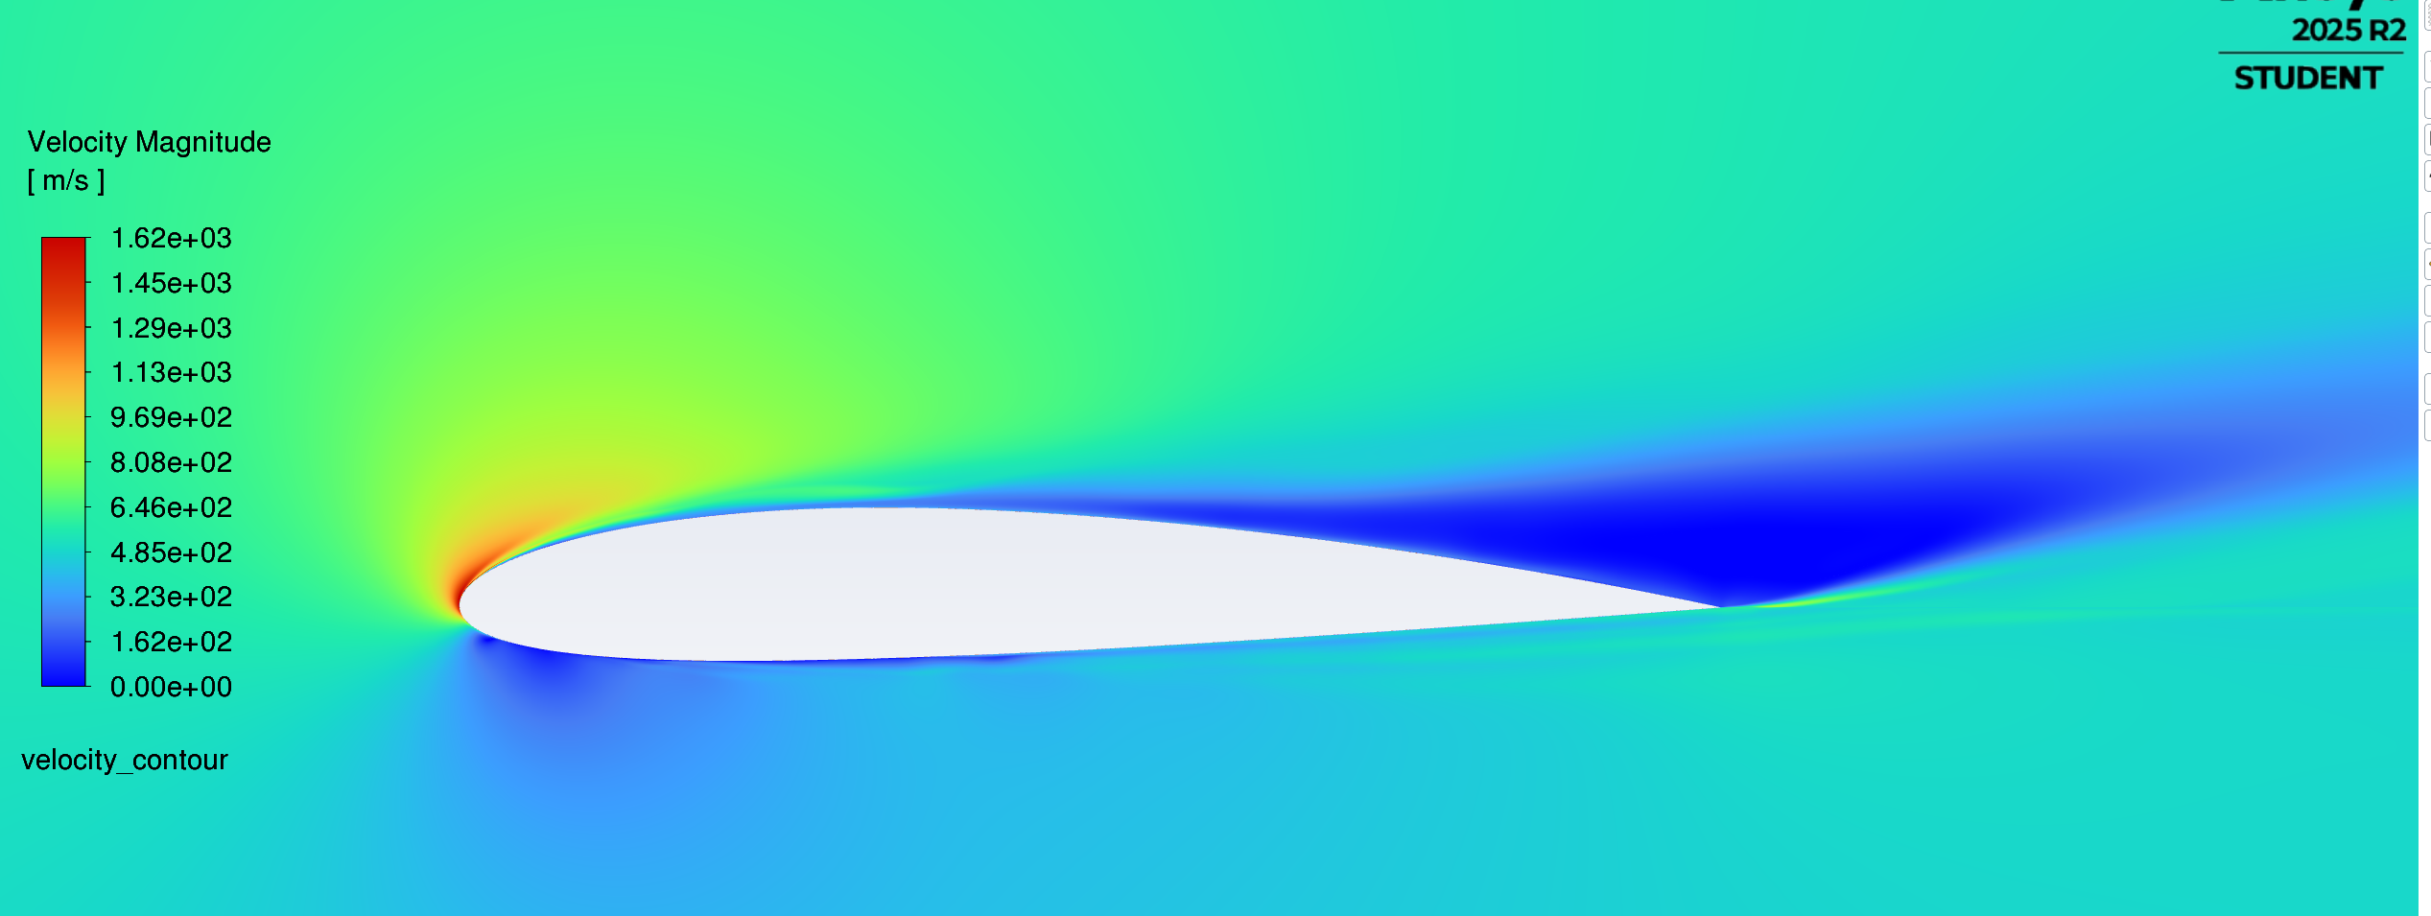
Key Results
Validation: Validation at Mach 0.13: Lift coefficients closely matched NASA data; drag less accurate due to mesh resolution.
Results of Compressible flow (Mach 1.0 and 1.5): Density solver captured turbulent wake; signs of shock interactions but not fully demonstrated at Mach 1.5, 16- angle of attack.
Outcome: Demonstrated Fluent’s capability of modeling subsonic and compressible flows over a simple airfoil geometry.
Figure 9. Velocity contour at Mach 1.5 (497 m/s) at 16° Angle of Attack.
Notes:
Key Results
Validation – The validation case was relatively accurate with the lift coefficients closely matching the NASA data and the drag less so due to limited mesh resolution and simplified flow modeling.
The outcome of this project was the demonstrated capability of using Fluent to model subsonic and compressible flows over simple 2D geometry.

Slide 11
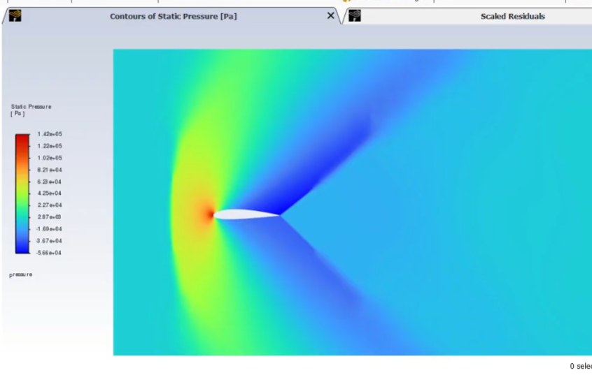
Conclusion
Figure 10. Pressure Contour of Flow over 2D Airfoil at Mach 1.2 Using Pressure-Based Solver (Armin Hashemi, YouTube Tutorial) – Shows more distinct pressure variations
Challenges: Mesh generation (bias reversal) and solver settings for turbulence modeling
Limitations: Drag prediction limited by steady-flow assumptions and mesh resolution.
Improvement: redo Mach 1.5 simulation with pressure-based and density-based solver to resolve shock waves.
Future work: unsteady simulations, 3D airfoils, and more complex geometries.
Notes:
The biggest challenges of this project were mesh generation caused by not reversing the bias in Mesh setup in Workbench when creating the fluid domain around the airfoil. I was able to resolve the issue by trying multiple mesh generations settings for the fluid domain and increasing the bias and reversing the bias in the outlet region. I kept getting swirly meshes in front and in the back of the airfoil.
Setting the turbulence solver settings were another challenge.
The limitations of this project were mainly the overestimation of the drag coefficient due to the use of steady-flow assumptions and limited mesh resolution which caused a discrepancy between my simulated data and the NACA experimental data.
The best improvement for this project would be to redo the Mach 1.5 simulation with pressure-based solver settings or detailed density-based solver to resolve the lack of shock waves.
Future work for this CFD project could explore unsteady simulations and simulations of the 2412 and other airfoils in three-dimensions to model complex flow behavior that is common in fluid system design such as airplane wings and fluid research problems.
This concludes my presentation.

Slide 12
References
Abbott, I.H., Doenhoff, A. E., & Stivers, L. S. (1945). Report No. 824 Summary of Airfoil Data National Advisor of Committee For Aeronautics (NACA).
Cillian Thomas. NACA2412 Tutorial in ANSYS Fluent (Student Version). (2023). YouTube. https://www.youtube.com/watch?v=3i9Ryq-m1HA.
Hashemi, Armin (2025). Airfoil Simulation of Subsonic, Transonic, & Supersonic Flow. YouTube. ANSYS Fluent Tutorial | Airfoil Simulation of Subsonic, Transonic & Supersonic Flow! (Figure 10.)
Kundu, P. K., Cohen, I. M., & Dowling, D. R. (2015). Fluid Mechanics (6th edition). Academic Press.
Sandoval, G. (2025). Incompressible Flow Over a 2D NACA 2412 Airfoil. Michigan Technological University, ME 5210 CFD Project Report.

Slide 13
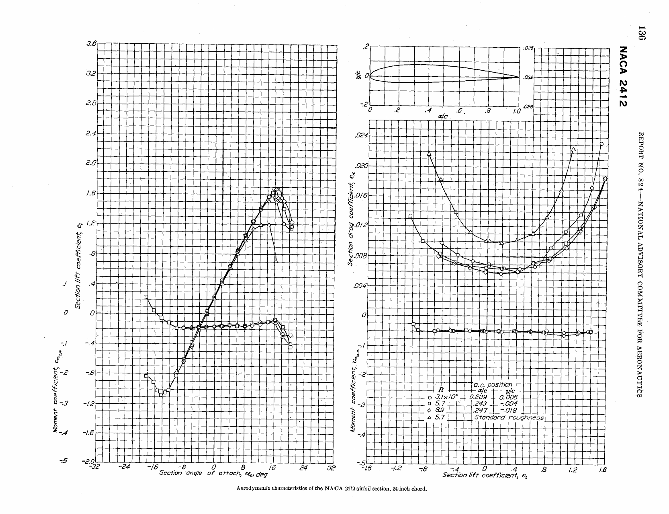
Appendix A
Figure 11. is the NACA 2412 Experimental Data at Mach 0.13.

Slide 14
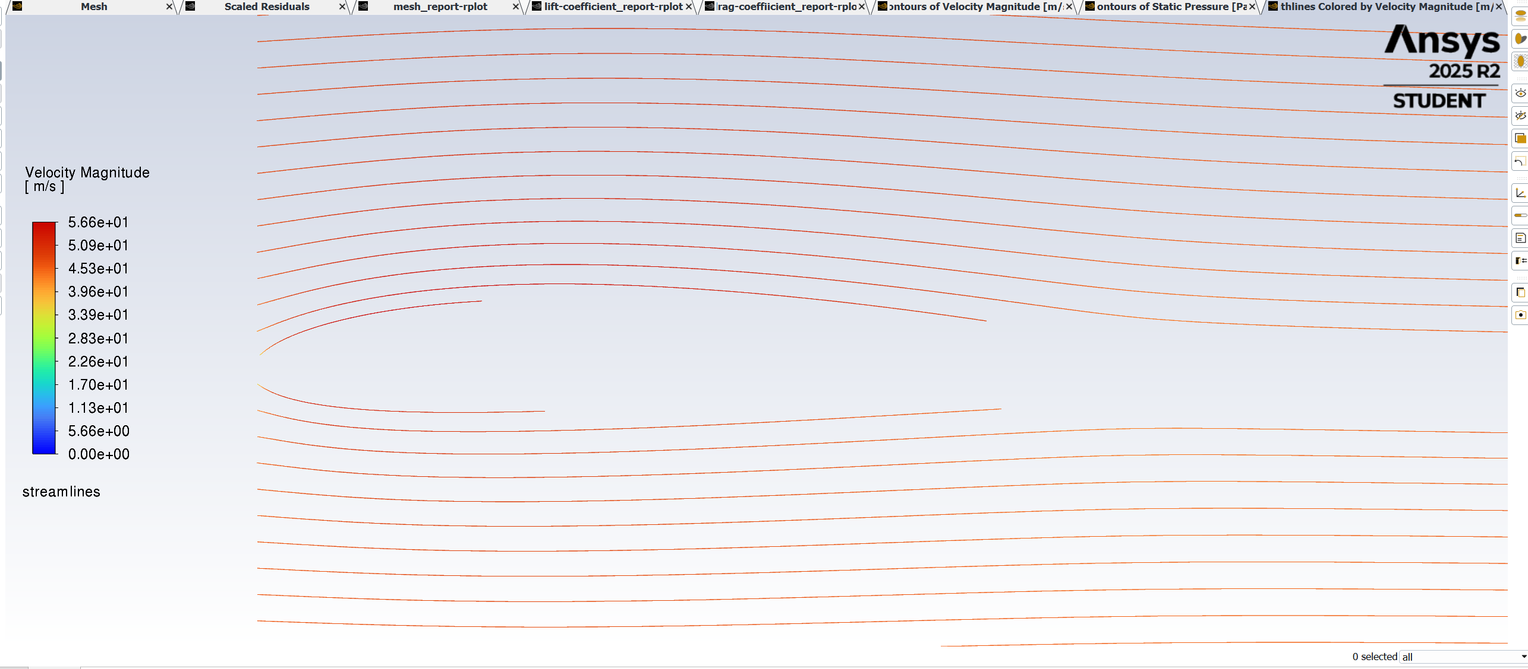
Appendix B
Figure 12. is the Streamlines of the 2412 at Mach 0.13.

